Slide 1
Modernization of IT and Accessibility with SharePoint Dean Halstead Director, Federal Accessibility Aneetha Jayaraman SharePoint Program Manager
Ben Truelove SharePoint Designer

Slide 2
Agenda
Modernization of IT and Accessibility
Getting Dial-tone in transformation
Accessibility is A11y
How SharePoint and Office are embracing Transformation
Exciting your leadership through demos

Slide 3
Modernization of IT is a once in a life time event

Slide 4
Accessibility outside Transformation

Slide 5
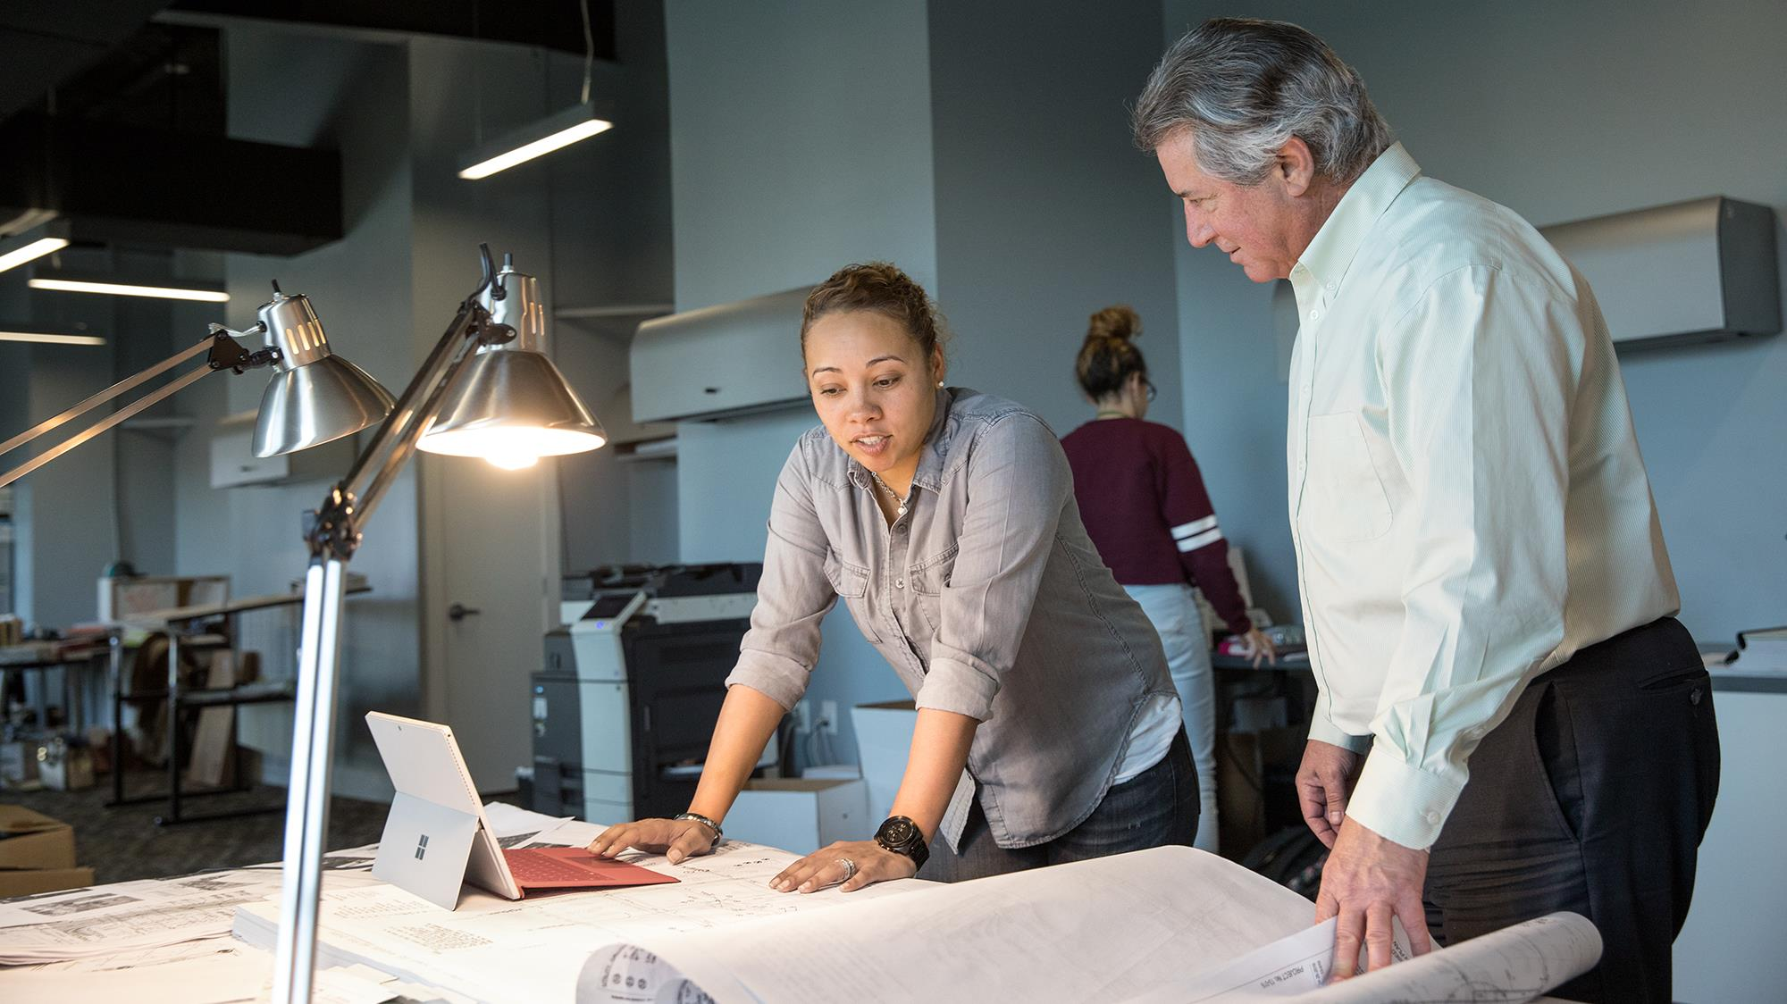




Existing View of IT Modernization and Accessibility
Mobility
Mobile Workers
Devices
Field Work
Commodity Devices
Digital Natives
Device Management
Security
Content Control
Encryption
Phishing
Auditing
Internet of Things
Privacy
Compliance
Content Protection
Archiving
Digital Assets
FOIA
Regulatory
Knowledge Capture
Accessibility
Accessibility of Content
Detecting Content
Guided Accessibility
Situational Disabilities
Workforce Inclusion
Training

Slide 6
Accessibility (A11y) is the key

Slide 7
A11y
Lens to innovation

Slide 8
A11y
Everyone needs to be included

Slide 9
A1=1y
Equality of Opportunity

Slide 10
A11y
Create Content for All

Slide 11
A1-1y
Transformation is about the Human experience

Slide 12
A11y
All employees benefit

Slide 13
Transformation Recap
Lens to innovation
Everyone needs to be included
Equality of Opportunity
Create Content for All
Transformation is about the Human Experience
All Employees benefit

Slide 14
So what does Modernization look like…SharePoint 365?

Slide 15

Empower every person and every organization on the planet to achieve more

Slide 16

SharePoint and our Mission
Powerful product +
Flexible platform =
Customizations

Slide 17
Goals
Help you champion SharePoint as a compliant, usable and inclusive solution
Learn the best practices we employ for better SharePoint Extensibility

Slide 18
Creating an accessible site
Ben Truelove

Slide 19
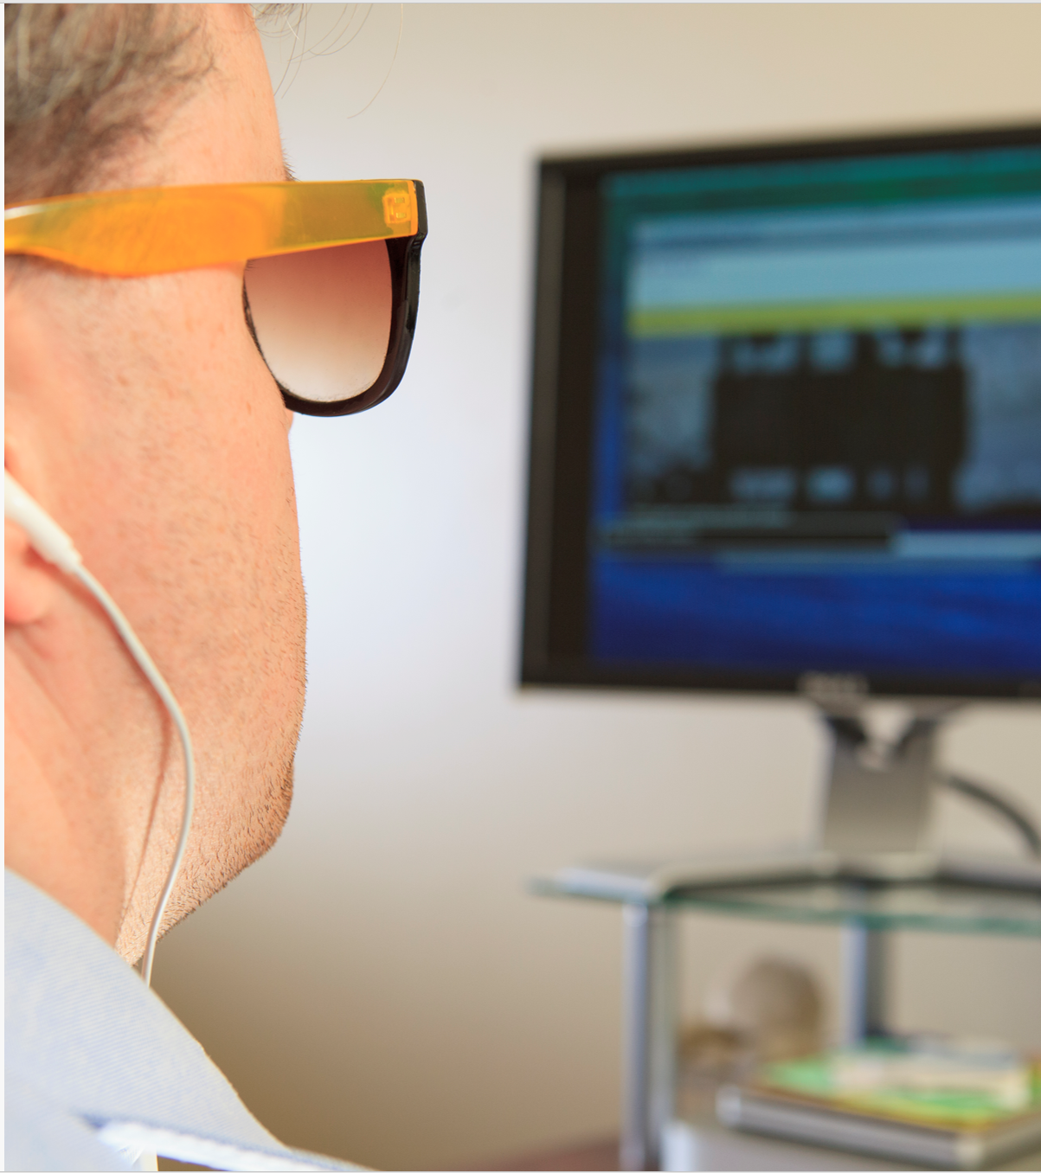
Accessibility 1-2-3
Accessibility Specifications
Accessibility Reviews and Conformance testing
Usability Testing

Slide 20
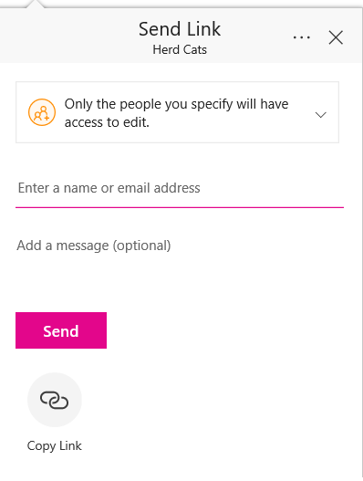
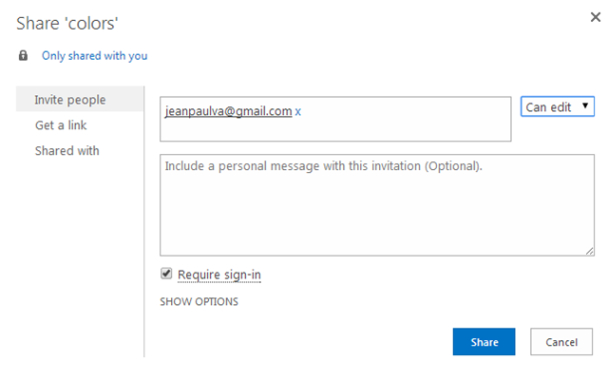
Compliance vs. Usable

Slide 21
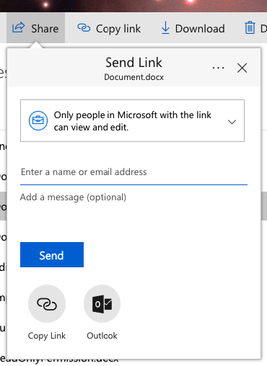

7
6
1
2
3
4
5

Slide 22
1
Visible label: Send Link to <Document name>
Label: Send Link to <Document name>
Role: Header
1
9
10
2
Visible label: Link settings: Only people in Microsoft with the link can view and edit.
Label:
Role: Setting
2
3
Visible label: Enter a name or email address
Label:
Role: text box
4
Visible label: Add a message (optional)
Label:
Role: text box
3
4
5
Visible label: Send
Label:
Role: Button
6
Visible label:
Label: Other ways to share link Role: Group (Not a tab stop)
5
7
Visible label: Copy Link
Label:
Role: Button
6
7
8
8
Visible label: Outlook
Label:
Role: Button
9
Label More options:
Role: Button
Tooltop: Popup
10
Label: Close
Role: Button

Slide 23
Share a document using voice
Ben Truelove

Slide 24
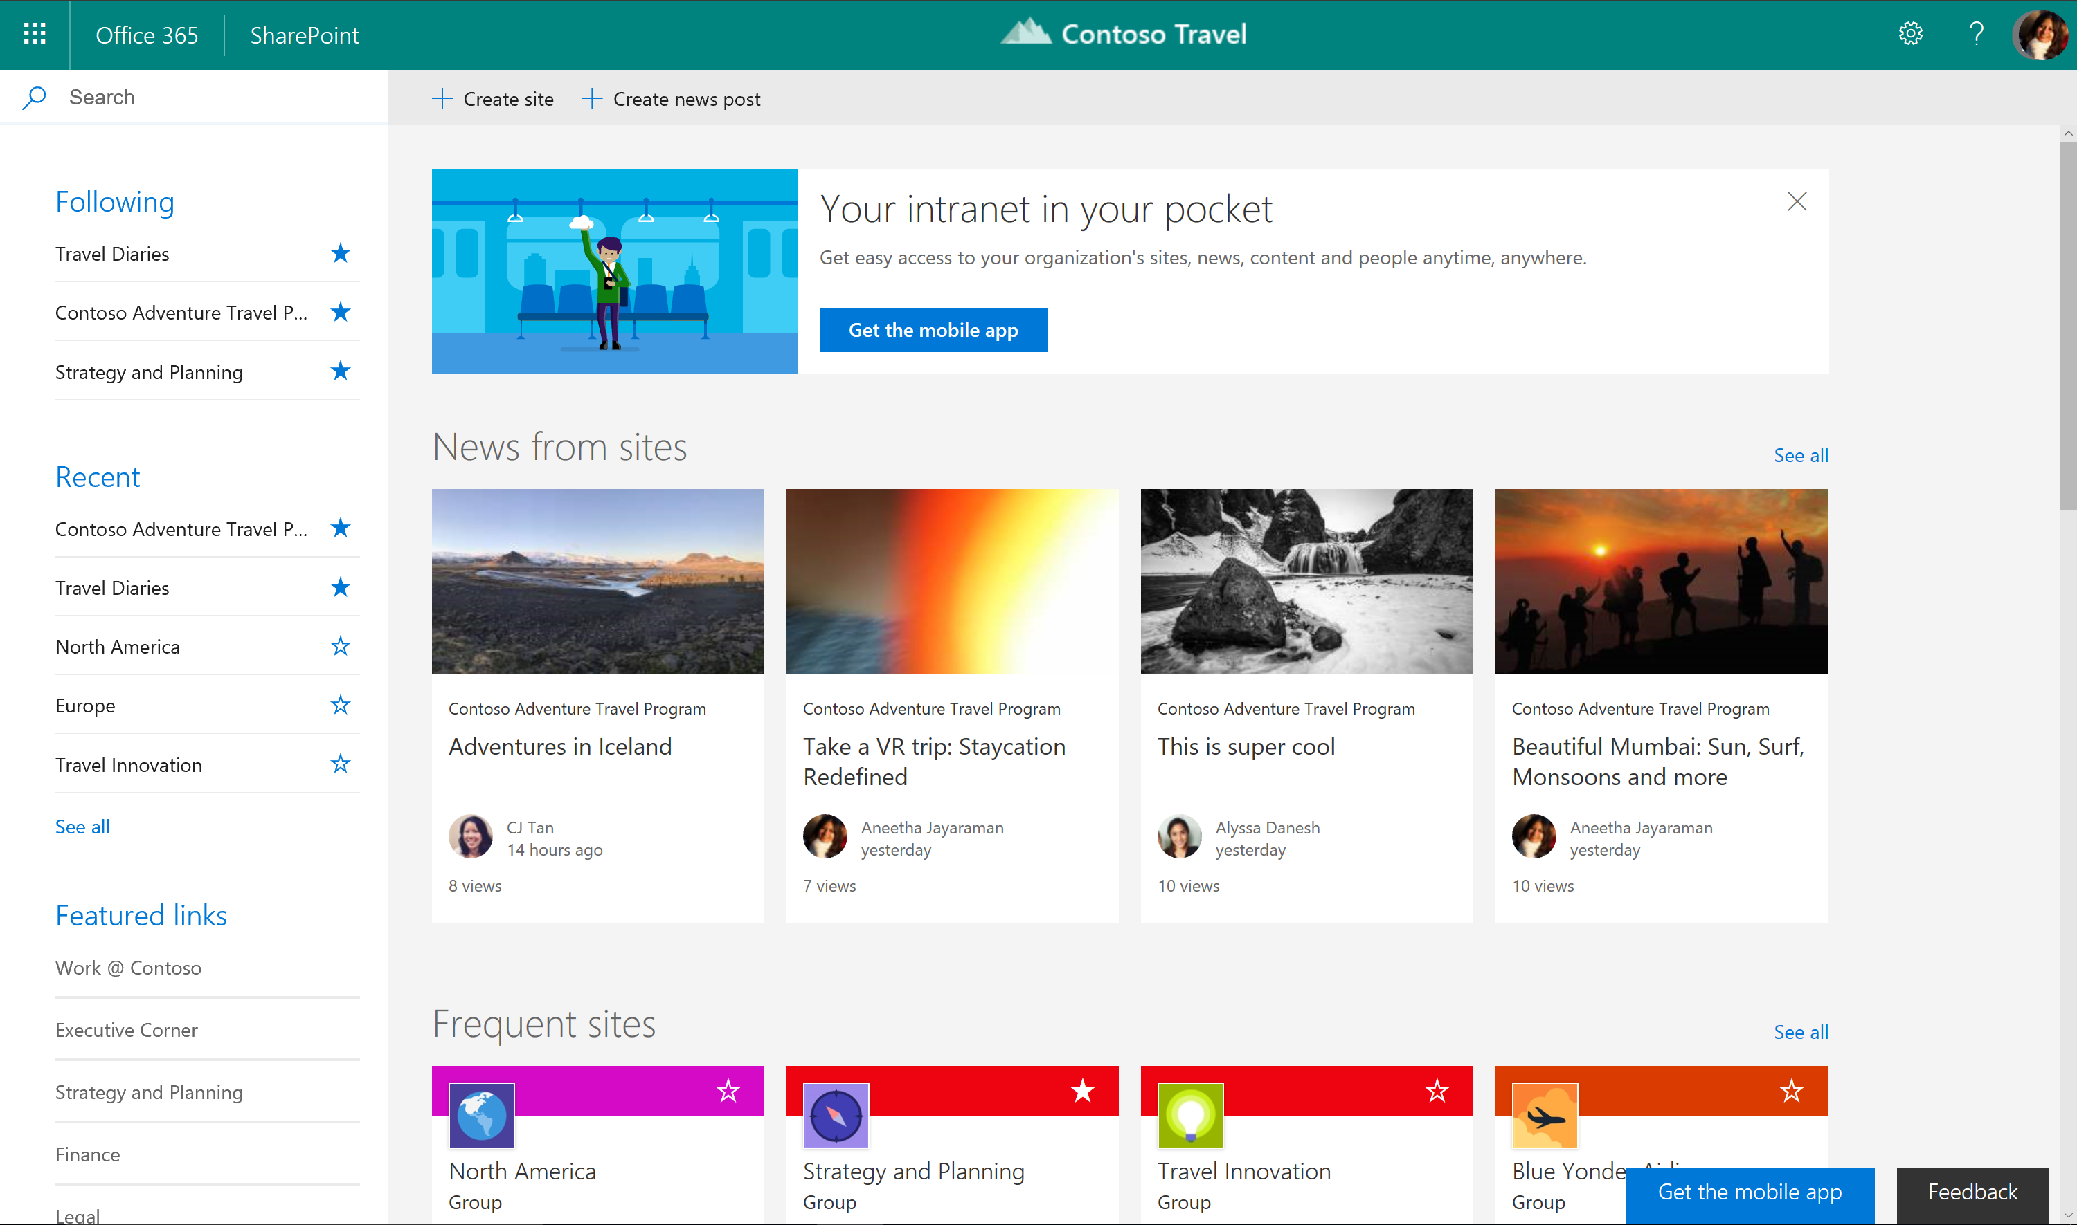
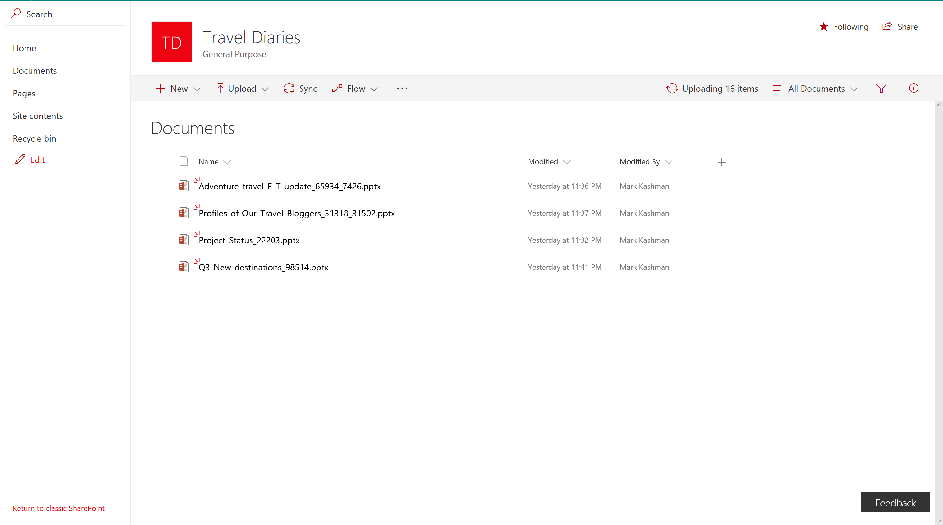
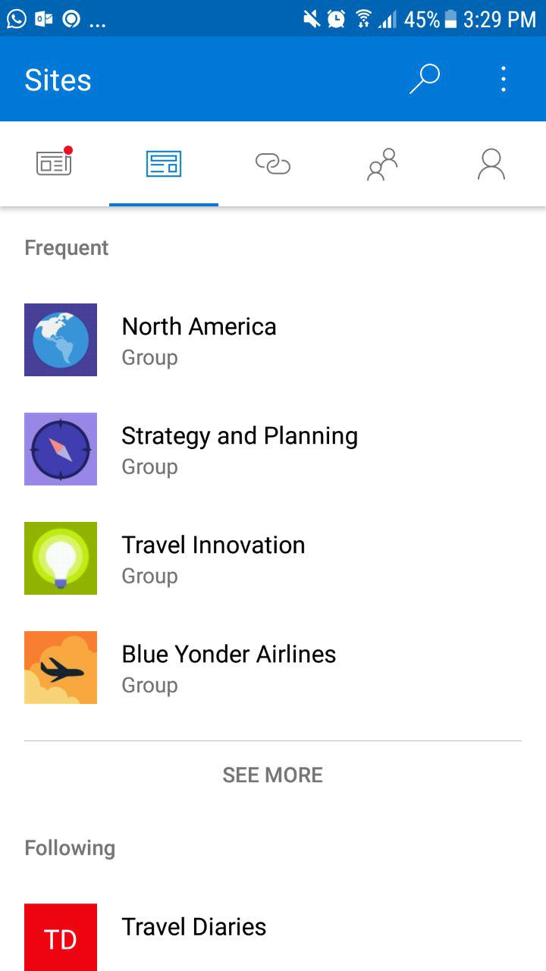
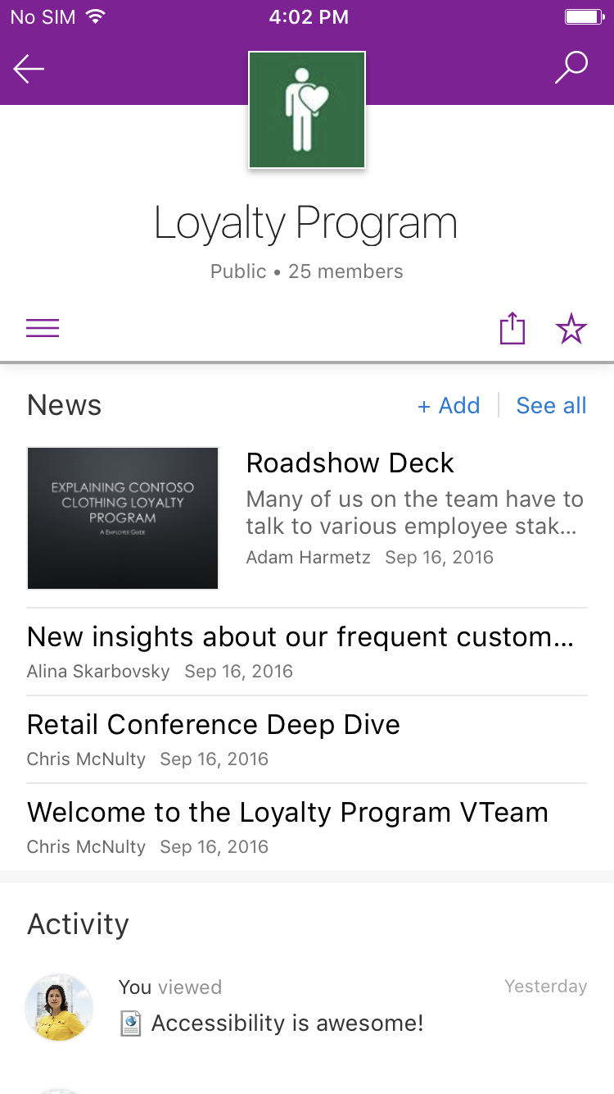
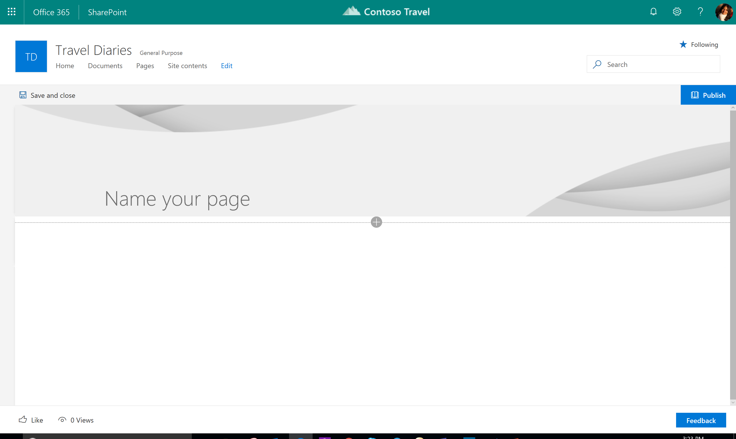
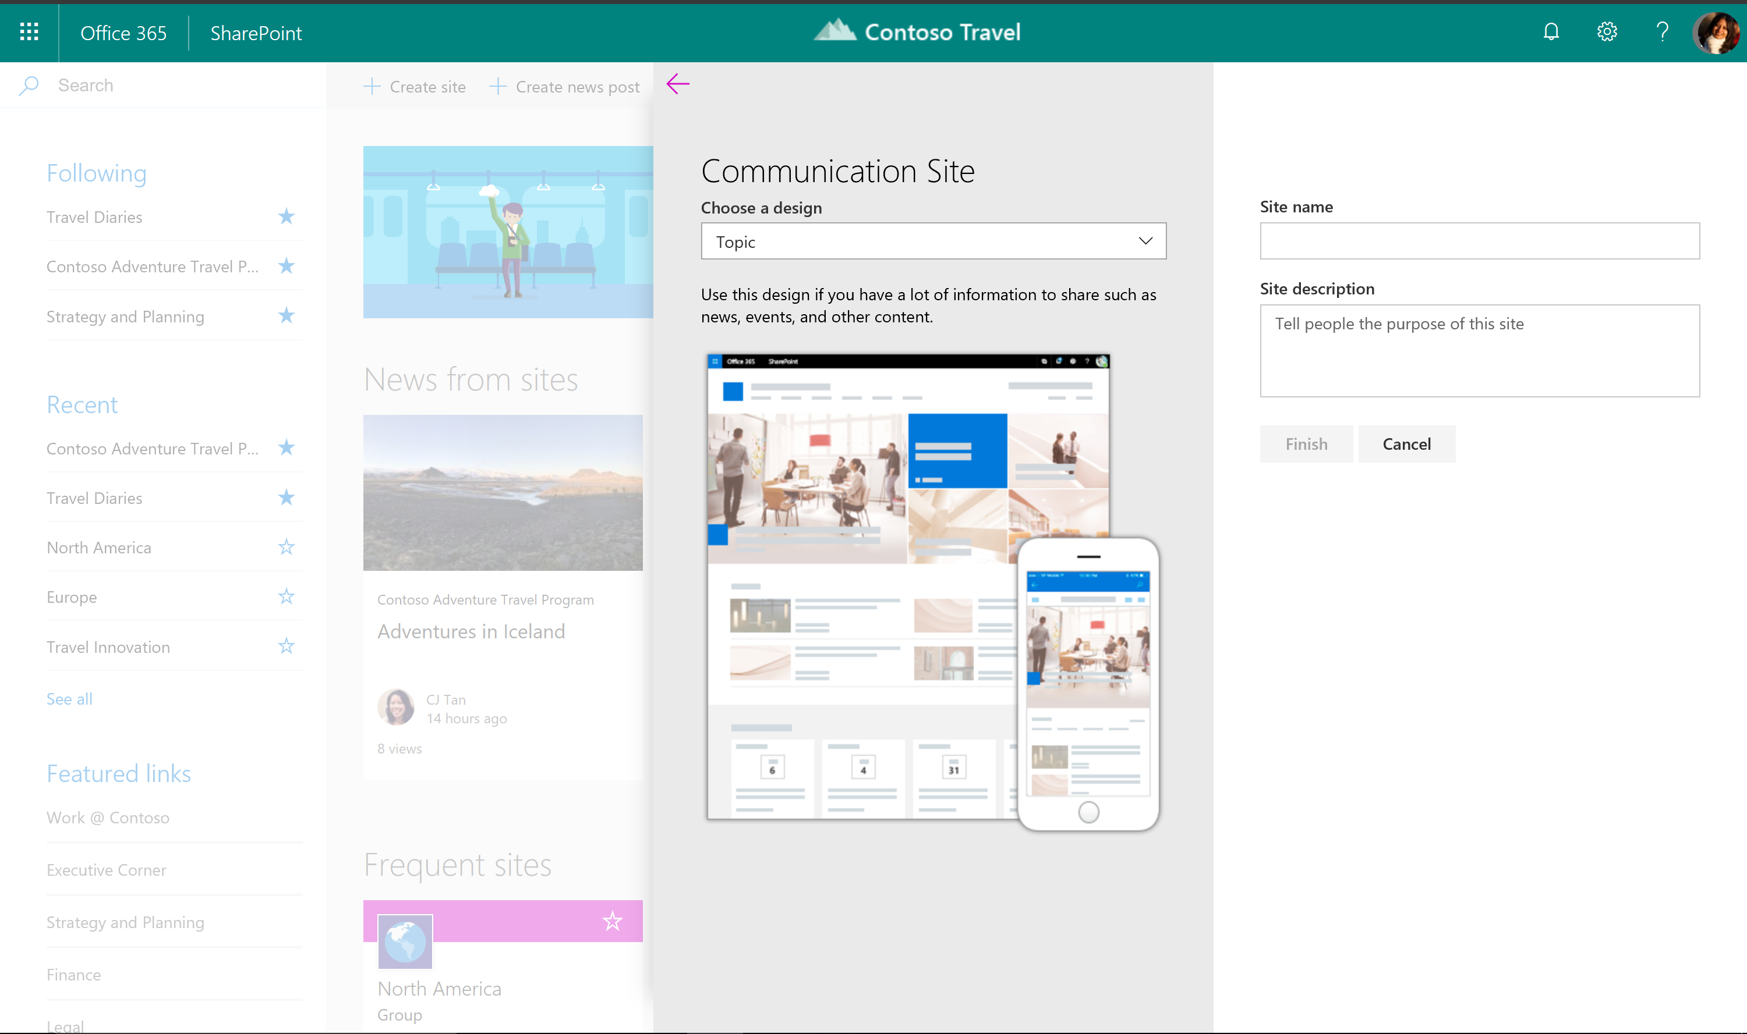
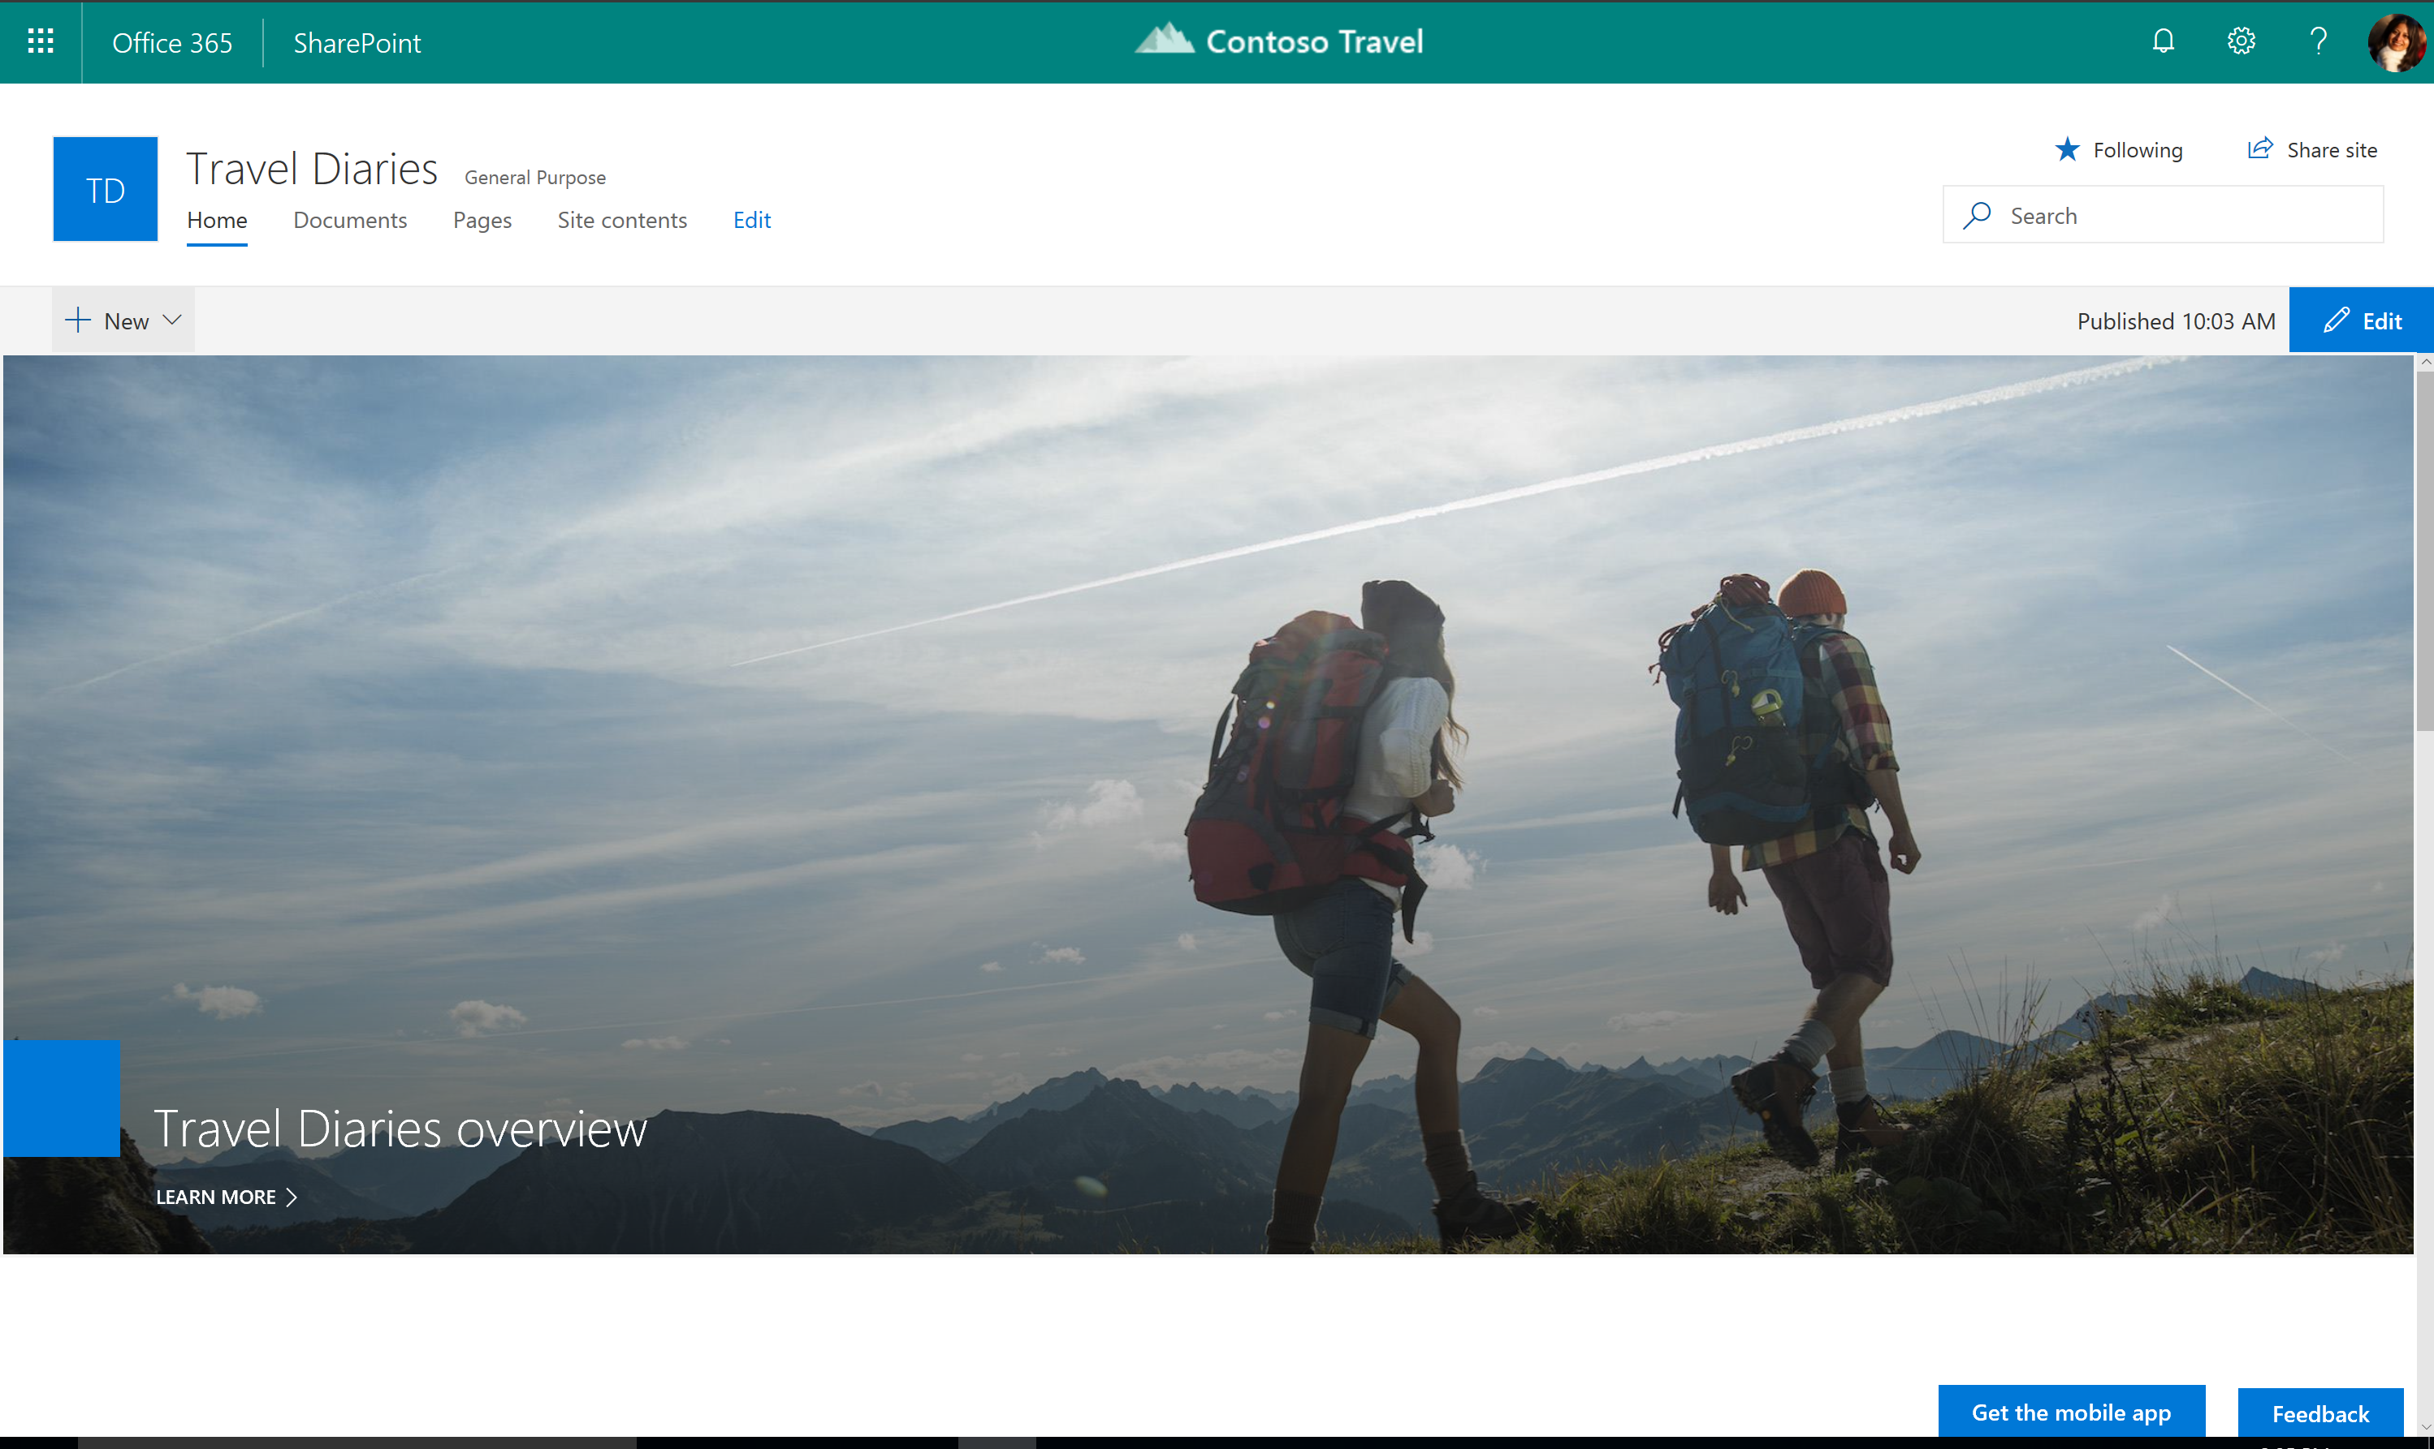
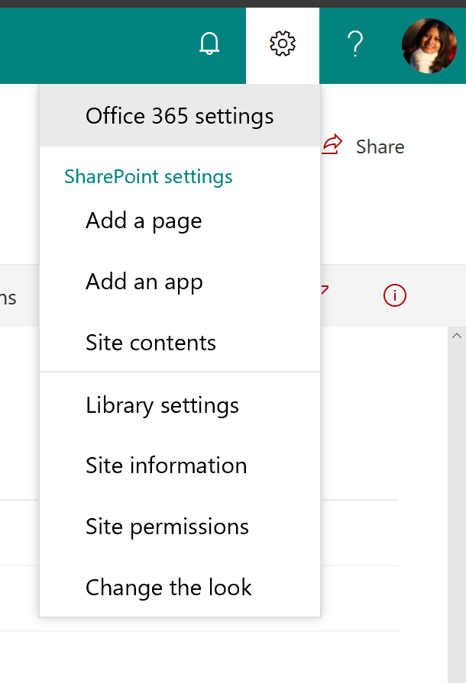
New work from the past year

Slide 25
SharePoint extensibility best practices
Use the SharePoint Framework
Provides full support for client-side SharePoint development, easy integration with SharePoint data, and support for open source tooling. More info at: https://dev.office.com/sharepoint/
Use Office UI Fabric React
Includes a robust collection of responsive, mobile-first components that are accessible and provide guidance on how to use them. More info at: http://dev.office.com/fabric/
Read our guidance
Explains the accessibility considerations of the page to web part model
Walkthrough on how to make the best out of Office UI Fabric
Test out your web part and customizations on Workbench

Slide 26
What’s next for us?

Slide 27

Upcoming investments
Accessibility Checker with
Rich Text Support
Contrast Checking

Slide 28

Key Takeaways
Help you champion SharePoint as a
compliant, usable and inclusive solution
Learn the best practices we employ
Check out the Fabric Resources page and get the XD toolkit

Slide 29
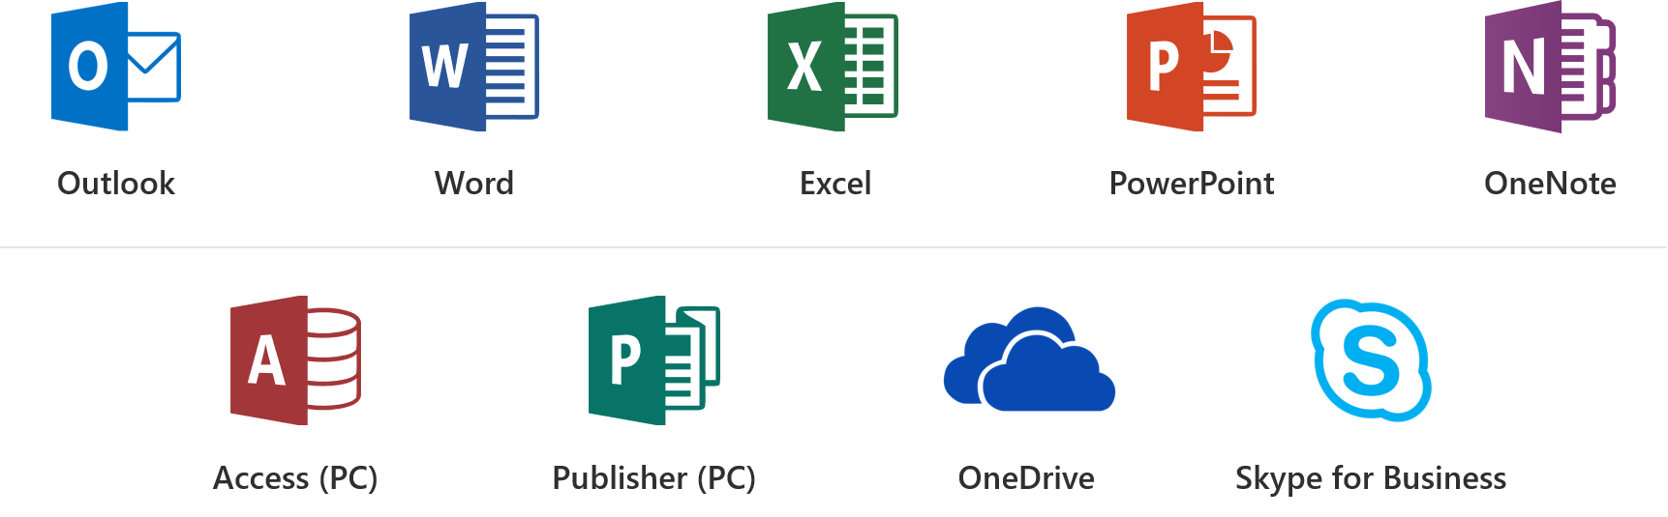
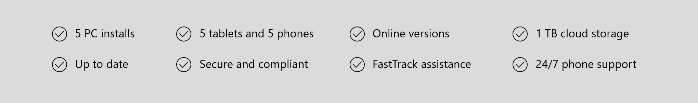
Office 365 ProPlus Overview

Slide 30
Office 365 Sessions at CSUN ATC
3/21 11am: What’s New in Microsoft Office 365
3/22 8am: Strategies to Make your IT Applications More Accessible
3/22 11am: Create Inclusive Classrooms with Microsoft Education
3/22 1.20pm: Microsoft Reading, Writing and Learning Tools
3/22 3.20pm: Excel 101 Tips and Tricks
3/22 4.20pm: Easily create accessible content with Office 365
3/23 9am: Modernization of IT with SharePoint Accessibility
3/23 11am: Create Engaging and Accessible Presentations with PowerPoint and Sway
3/23 2.20pm: How I used Microsoft OneNote to Manage a Medical Crisis
3/23 4.20pm: Software Architecture in Office 365 for Exposing Accessible Content

Slide 31
Resource Links
Microsoft at CSUN
Aka.ms/CSUN2018
Answer Desk for Accessibility Support
aka.ms/eDAD
Microsoft Accessibility Overview
Microsoft.com/Accessibility

Slide 32
We want to hear from you.
Connect with us in person today or anytime through our support and feedback channels.
Disability Answer Desk for phone/chat/ASL Help: Aka.ms/AccessibilitySupport
User voice Forum for Accessibility Feedback: Aka.ms/AccessibilityFeedback

